Slide 1

Abortions By Political Affiliation
Felipe Castillo

Slide 2
Hypothetical Question
Are abortions evenly distributed between political affiliations?
Does one political affiliation have higher number of cases than the other?
What age group is more likely to get an abortion?
Does the availability of clinics correlate to a higher abortion rate?
Are abortions on a rise ?

Slide 3
Texas New Abortion Law
Texas law now bans most abortions are six weeks
This law forces clinics to close the door to anyone after that time frame
The impact is untested due to Roe vs. Wade of 1973
Link: https://www.nytimes.com/2021/09/01/health/texas-abortion-law-facts.html

Slide 4
5 Variables To Be Analyzed
Total abortions
Political Affiliation
Abortions by Year
Age
Clinic availability

Slide 5
Political Affiliation
Is defined by a state political standing as of 2016 election
Example: Texas is Republican while California is Democratic
This is an assumption due to the nature of political change

Slide 6
Total Abortions For All States Combined
Mean 16879.41176470588
Median 8950.0
Mode 0 4780
dtype: int64
SD 25377.99

Slide 7
Total Abortions Republican States
Mean: 10804.8
Median:11525.03
Std: 30750.58

Slide 8
Total Abortions Democratic States
Mean: 22720.38
Median:11525.0
STD:30750.58

Slide 9
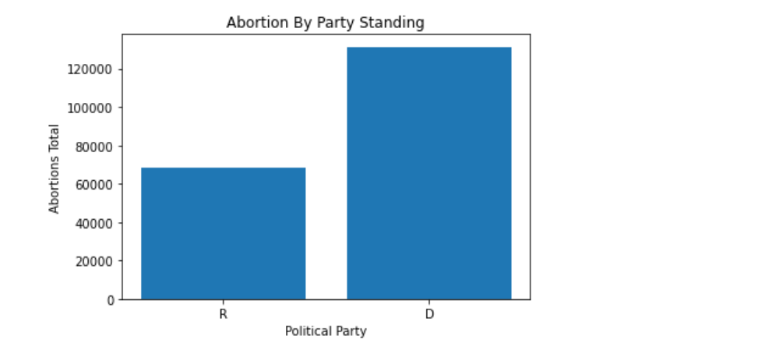
Total Abortions Compared

Slide 10
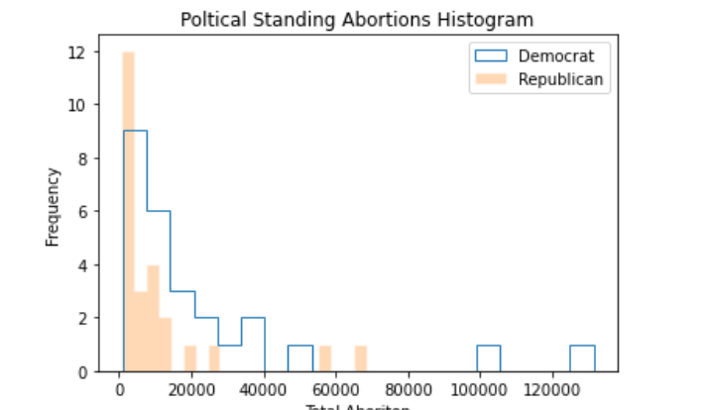
Total Abortions Compared Histogram
Graph is right skewed
Two main outliers for Democrat stand out
Democrat states see higher numbers of abortion across the board

Slide 11
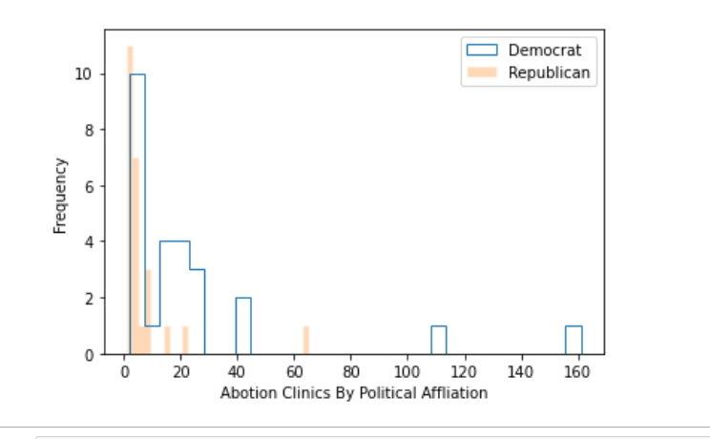
Clinic Availability
Republican Mean: 7.32
Democratic Mean: 24.04

Slide 12
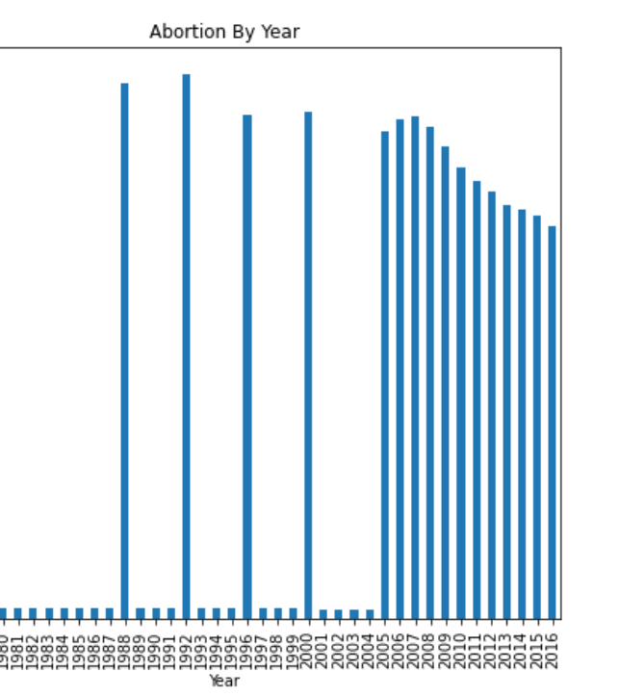
Abortions by Year
It stands to reason that the total abortion rate has seen a decline
It is unknown if there is other legislation that leads to this decline

Slide 13
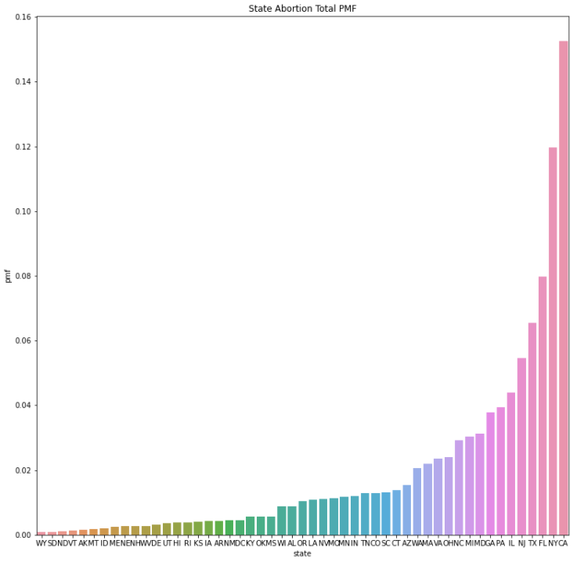
Total abortions PMF
Wyoming has the smallest PMF value while California has the highest. What's interesting is that Texas and Florida a Republican state also has a high abortion PMFs.

Slide 14
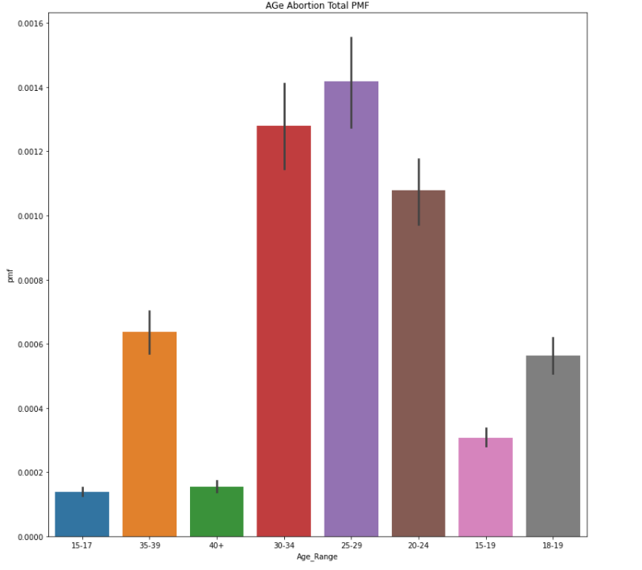
Total PMF BY Age
My predication was that there would be a lot more abortions in the 15-17. The PMF is higher from 25-34. The highest being .0016 PMF between ages 25-29.

Slide 15
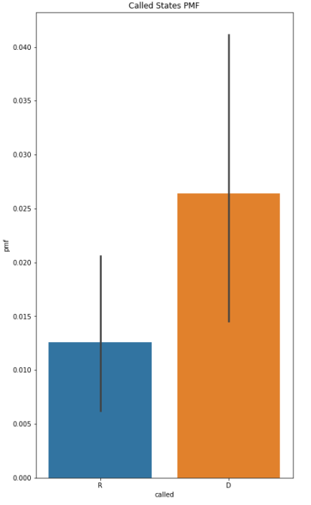
PmF by Political Affiliation
The data shows that the PMF for D is higher. While R is a smaller amount.

Slide 16
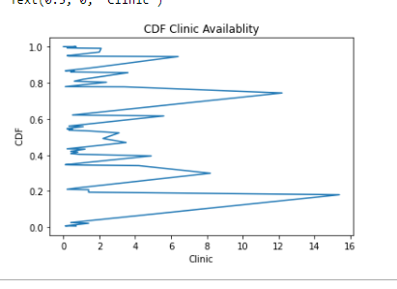
CDF Clinic Availability
CDF are all over the board.

Slide 17
Null Hypothesis
#null hypothesis: Clinic availability does not mean more abortions
#alternative: More clinic availability means more
abortions.number_of_abortion = clinic_availablity['No. of abortions']
number_of_clinics = clinic_availablity['Number_Of_Clinics']
stat , p = spearmanr(number_of_abortion,number_of_clinics )
print(stat , p)
if p > 0.05:
print("Does not support a strong enough claim that it effects the population.")
else:
print(p)
print("Has enough evidence to support claim")
With a P Value 3.466203958646422e-14f
Which rejects the null hypothesis. And clinics do matter.

Slide 18
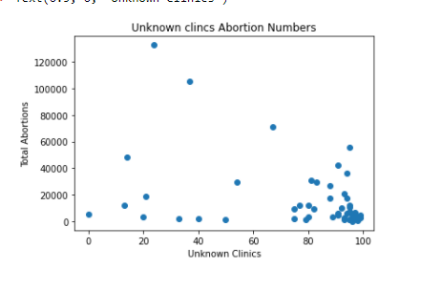
Unknown clinics
This is the unknown record of other clinics that are opened in some of the states. Perhaps this reading could be clinics that are being built or other licensing issues. The others could be small time companies while the others are more recognized.

Slide 19
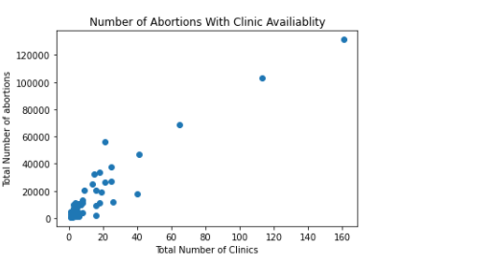
Scatter Plot Number of Clinics
Overall, most dots are positioned at the beginning of the graph. There are a few outliers which have been established from the beginning.

Slide 20
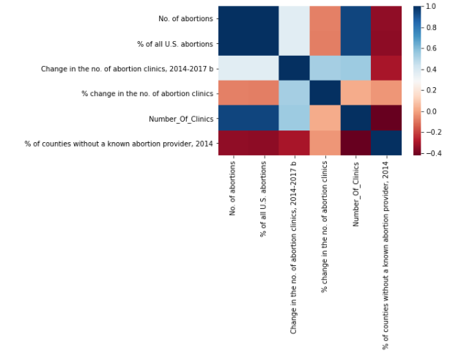
Heat Map clinics Abortion
Finding the correlation in clinic availability.

Slide 21
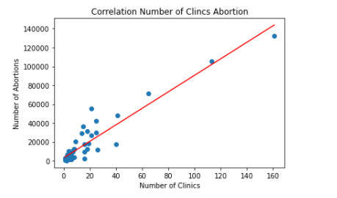
Linear regression
There is a correlation between number of clinics with the number of abortion. So, its stands to reason that with less clinic mean less abortion.

Slide 22
Gone Over
Democratic states have double the number of abortions of Republican State.
Abortion are on current decline. Other sources also suggest the same. Yearly it's been going down.
The highest abortion probability is around 25 – 34.
Clinic availability does have some correlation with abortion.
Political Affiliation between states does have some correlation with total abortions.

Slide 23
Conclusion
Abortions are not distributed evenly between political affiliation . Democratic states have double the number of abortions.
Assumption had to made about individuals within a state.
Availability of clinics should have a correlation to total number of abortion.
Texas laws should see an impact with the total number of abortion.

